Slide 1
Graphs and Graph Algorithms 1

Slide 2

Remainder of the semester plan
Self-directed learning: Crypto currencies
Graph algorithms continuation
Self-directed learning
Self-directed learning
Review for Exam 2
IT and Ethics debate 2
Assignment 2 due
Students presentations
Exam 2

Slide 3
I know this is a bummer but I would appreciate if you could complete the Student Perception of Teaching (SPOT) for ADS

Slide 4
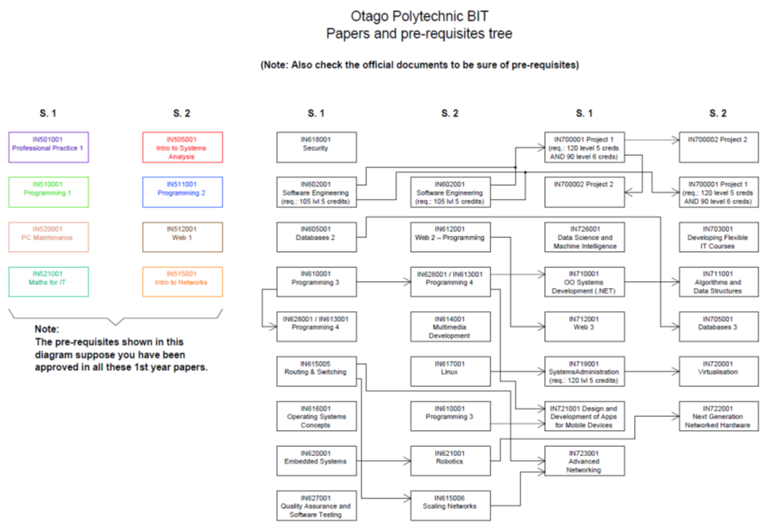
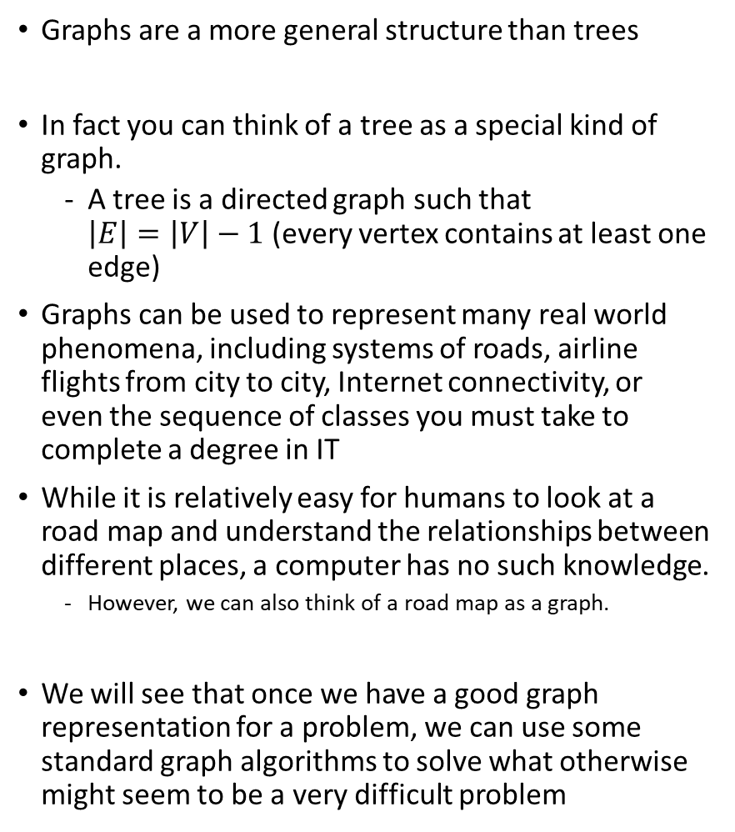
Introduction
Graphs are a more general structure than trees
In fact you can think of a tree as a special kind of graph.
A tree is a directed graph such that $\left|E\right|=\left|V\right|−1$ (every vertex contains at least one edge)
Graphs can be used to represent many real world phenomena, including systems of roads, airline flights from city to city, Internet connectivity, or even the sequence of classes you must take to complete a degree in IT
While it is relatively easy for humans to look at a road map and understand the relationships between different places, a computer has no such knowledge.
However, we can also think of a road map as a graph.
We will see that once we have a good graph representation for a problem, we can use some standard graph algorithms to solve what otherwise might seem to be a very difficult problem

Slide 5
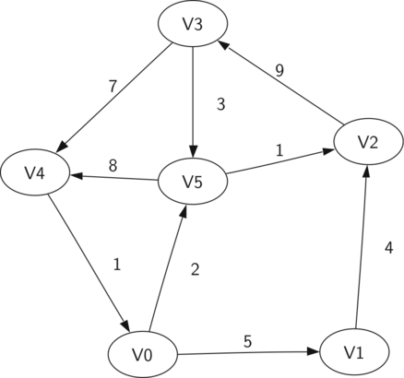
Vocabulary and definitions
Vertex: (also called a “node”) is a fundamental part of a graph. It can have a name, which we will call the “key.”
A vertex may also have additional information (the “payload”)
Edge: (also called an “arc”) connects two vertices to show that there is a relationship between them.
Edges may be one-way or two-way.
If the edges in a graph are all one-way, we say that the graph is a directed graph, or a digraph.
Weight: Edges may be weighted to show that there is a cost to go from one vertex to another.
For example in a graph of roads that connect one city to another, the weight on the edge might represent the distance between the two cities.

Slide 6


Vocabulary and definitions
Graph: A graph can be represented by G where G=(V,E). For the graph G, V is a set of vertices and E is a set of edges. Each edge is a tuple (v,w) where w,v∈V. We can add a third component to the edge tuple to represent a weight. A subgraph s is a set of edges e and vertices v such that e⊂E and v⊂V.
Path: A path in a graph is a sequence of vertices that are connected by edges. Formally we would define a path as w₁,w₂,...,w_{n} such that (w_{i},w_{i+1})∈E for all 1≤i≤n−1. The unweighted path length is the number of edges in the path, specifically n−1. The weighted path length is the sum of the weights of all the edges in the path. For example in the Figure the path from V3 to V1 is the sequence of vertices (V3,V4,V0,V1). The edges are {(v3,v4,7),(v4,v0,1),(v0,v1,5)}.
Cycle: in a directed graph a cycle is a path that starts and ends at the same vertex. For example, in the Figure the path (V5,V2,V3,V5) is a cycle. A graph with no cycles is called an acyclic graph. A directed graph with no cycles is called a directed acyclic graph or a DAG.
We will see that we can solve several important problems if the problem can be represented as a DAG.

Slide 7
The graph abstract data type
The graph abstract data type (ADT) is defined as follows:
Graph() creates a new, empty graph.
addVertex(vert) adds an instance of Vertex to the graph.
addEdge(fromVert, toVert) Adds a new, directed edge to the graph that connects two vertices.
addEdge(fromVert, toVert, weight) Adds a new, weighted, directed edge to the graph that connects two vertices.
getVertex(vertKey) finds the vertex in the graph named vertKey.
getVertices() returns the list of all vertices in the graph.
in returns True for a statement of the form vertex in graph, if the given vertex is in the graph, False otherwise.
Beginning with the formal definition for a graph there are several ways we can implement the graph abstract data type
We will see that there are trade-offs in using different representations to implement the ADT described above.
There are two well-known implementations of a graph
adjacency matrix
adjacency list

Slide 8
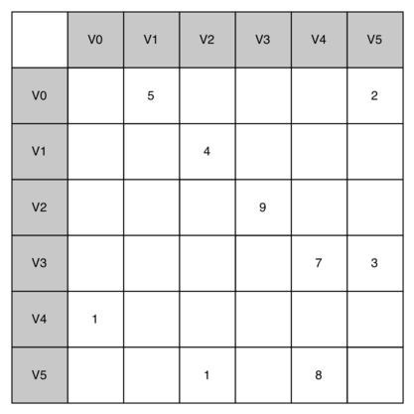
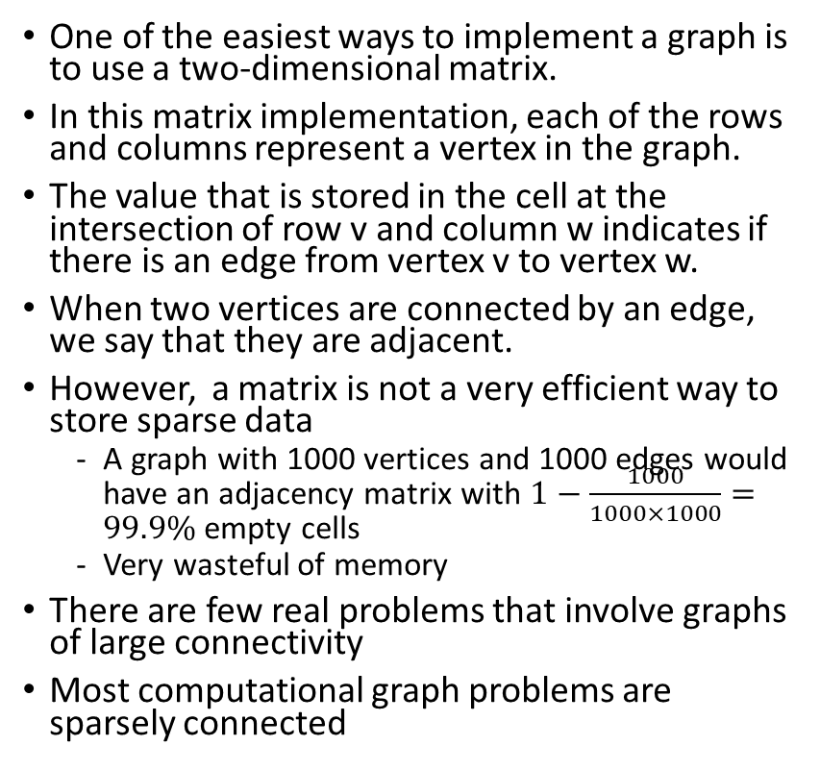
Representing a graph as an adjacency matrix
One of the easiest ways to implement a graph is to use a two-dimensional matrix.
In this matrix implementation, each of the rows and columns represent a vertex in the graph.
The value that is stored in the cell at the intersection of row v and column w indicates if there is an edge from vertex v to vertex w.
When two vertices are connected by an edge, we say that they are adjacent.
However, a matrix is not a very efficient way to store sparse data
A graph with 1000 vertices and 1000 edges would have an adjacency matrix with $1−\frac{1000}{1000×1000}=99.9\%$empty cells
Very wasteful of memory
There are few real problems that involve graphs of large connectivity
Most computational graph problems are sparsely connected

Slide 9
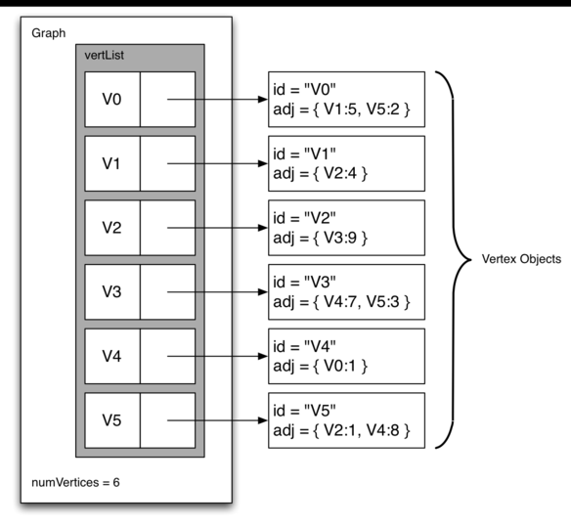
Representing a graph as an Adjacency List
A more space-efficient way to implement a sparsely connected graph is to use an adjacency list or map.
In an adjacency list implementation we keep a master list or map of all the vertices in the Graph object and then each vertex object in the graph maintains a list or map of the other vertices that it is connected to.
In our implementation of the Vertex class we will use a map (i.e. a dictionary in python) rather than a list where the dictionary keys are the vertices, and the values are the weights

Slide 10
Shortest path applications of Graphs: The Word Ladder Problem
Let’s consider the following puzzle called a word ladder.
Transform the word “FOOL” into the word “SAGE” by changing one letter at a time.
Constraint: At each step you must transform one word into another word, you are not allowed to transform a word into a non-word.
Example:
FOOL→POOL→POLL→POLE→PALE→SALE→SAGE
We can solve this problem using a graph algorithm.
Represent the possible transitions between words (relationships) as a graph.
We can find several possible solutions for a word ladder puzzle
Using the graph algorithm known as breadth first search we can find the shortest path from the starting word to the ending word.

Slide 11
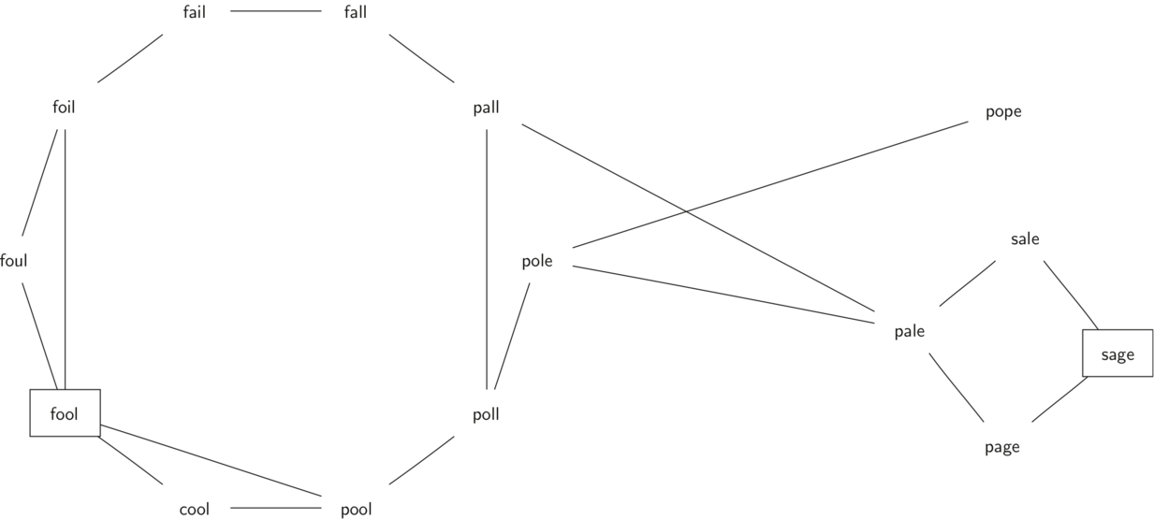
Building the Word Ladder Graph
Our first problem is to figure out how to turn a large collection of words into a graph.
What we would like is to have an edge from one word to another if the two words are only different by a single letter.
If we can create such a graph, then any path from one word to another is a solution to the word ladder puzzle.
The following is a small graph of some words that solve the FOOL to SAGE word ladder problem
Notice that the graph is an undirected graph and that the edges are unweighted

Slide 12
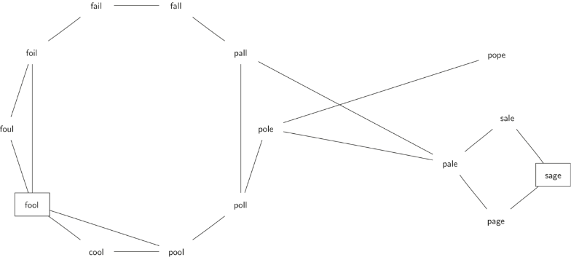
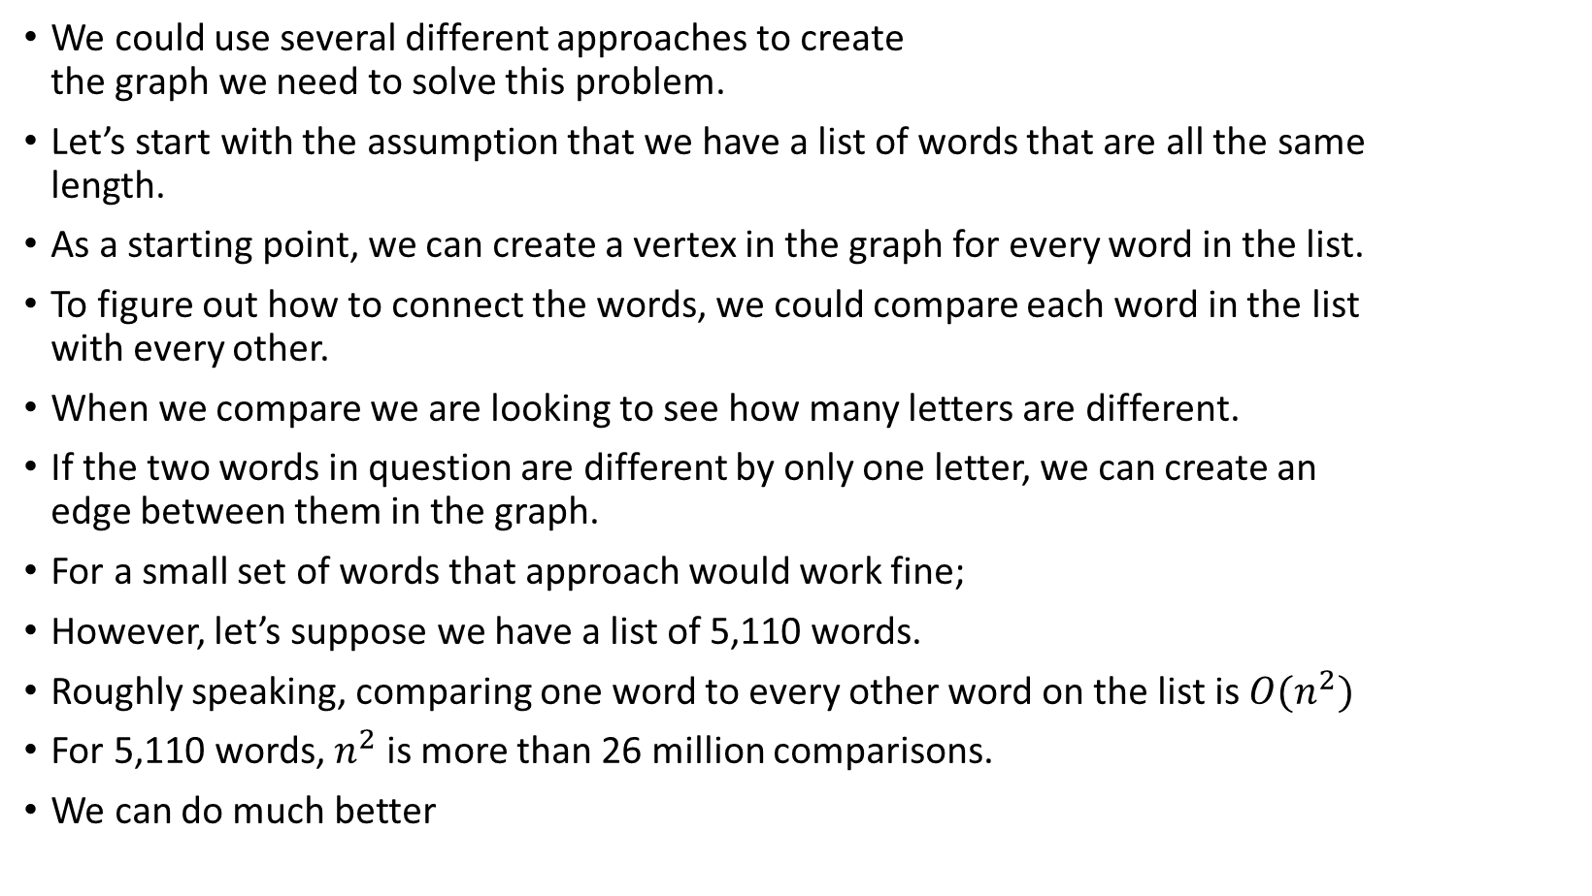
Building the Word Ladder Graph
We could use several different approaches to create the graph we need to solve this problem.
Let’s start with the assumption that we have a list of words that are all the same length.
As a starting point, we can create a vertex in the graph for every word in the list.
To figure out how to connect the words, we could compare each word in the list with every other.
When we compare we are looking to see how many letters are different.
If the two words in question are different by only one letter, we can create an edge between them in the graph.
For a small set of words that approach would work fine;
However, let’s suppose we have a list of 5,110 words.
Roughly speaking, comparing one word to every other word on the list is $O(n^{2})$
For 5,110 words, $n^{2}$ is more than 26 million comparisons.
We can do much better
NAIF
NAIL
NAME
NANA
NANS
NAOI
NAOS
NAPE
NAPS
NARC
NARD
NARK
NARY
NAVE
NAVY
…

Slide 13
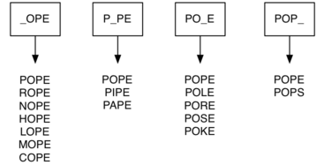
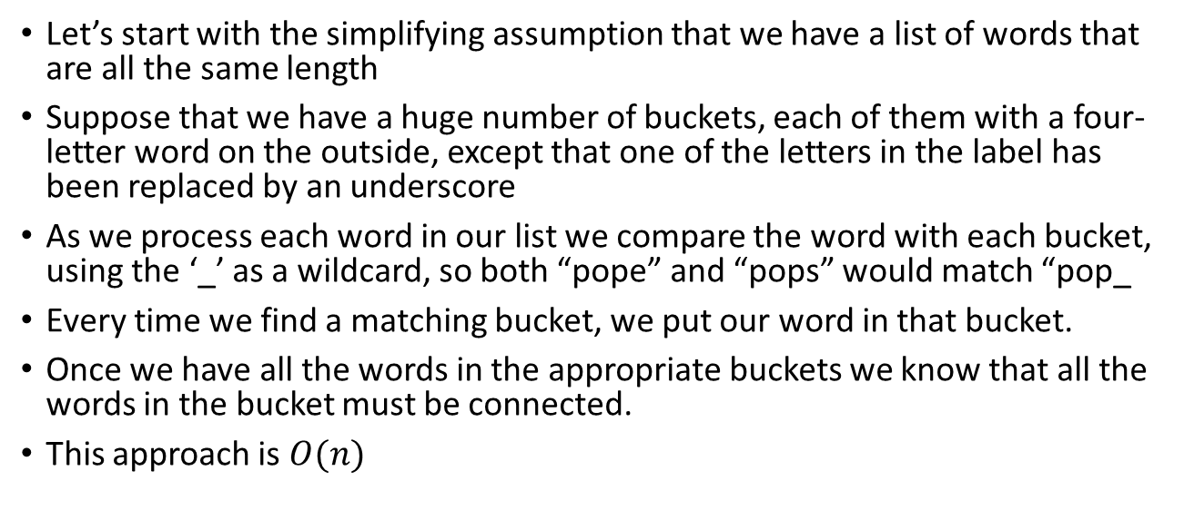
Building the Word Ladder Graph
Let’s start with the simplifying assumption that we have a list of words that are all the same length
Suppose that we have a huge number of buckets, each of them with a four-letter word on the outside, except that one of the letters in the label has been replaced by an underscore
As we process each word in our list we compare the word with each bucket, using the ‘_’ as a wildcard, so both “pope” and “pops” would match “pop_
Every time we find a matching bucket, we put our word in that bucket.
Once we have all the words in the appropriate buckets we know that all the words in the bucket must be connected.
This approach is $O(n)$
NAIF
NAIL
NAME
NANA
NANS
NAOI
NAOS
NAPE
NAPS
NARC
NARD
NARK
NARY
NAVE
NAVY
…

Slide 14
The importance of representing the graph as an adjacency list instead of an adjacency matrix
Since this is our first real-world graph problem, you might be wondering how sparse is the graph?
The list of four-letter words we have for this problem in the practical is 5,110 words long.
If we were to use an adjacency matrix, the matrix would have
5,110 * 5,110 = 26,112,100 cells.
The graph constructed by the buildGraph function in the practical as described in the previous slide has exactly 53,286 edges,
so the matrix would have only 0.20% of the cells filled!
99.8% unused space
That is a very sparse matrix indeed and a huge waste of storage space

Slide 15
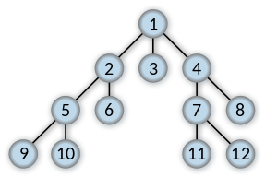
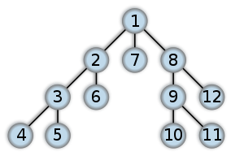
Breadth First Search and Depth First Search
Breadth-first search (BFS) is an algorithm for traversing or searching graph data structures.
A tree is a type of graph
BFS starts at the tree root (or some arbitrary node of a graph), and explores all of the neighbor nodes at the present depth prior to moving on to the nodes at the next depth level.
This is in contrast to Depth-first search (DFS) another algorithm for traversing or searching tree or graph data structures.
DFS starts at the root node (selecting some arbitrary node as the root node in the case of a graph) and explores as far as possible along each branch before backtracking.
Breadth-first search (BFS)
Depth-first search (DFS)

Slide 16
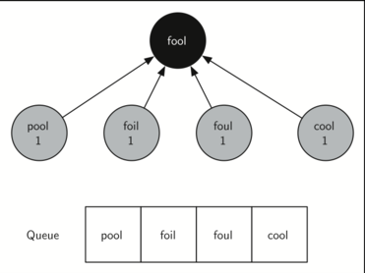
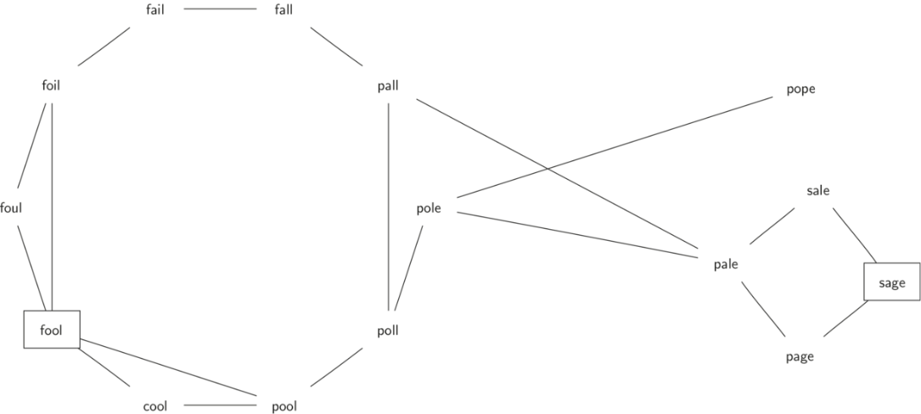
Implementing Breadth First Search on a graph
Let’s look at how a bfs function would construct the breadth first tree corresponding to the graph
BFS uses a Queue, a crucial point as we will see, to decide which vertex to explore next.
Starting from fool we take all nodes that are adjacent to fool and add them to the queue.
BFS builds a search tree one level at a time

Slide 17
Implementing Breadth First Search on a graph
BFS begins at the starting vertex start and colors start gray to show that it is currently being explored.
Two other values, the distance and the predecessor, are initialized to 0 and None respectively for the starting vertex.
Finally, start is placed on a Queue.
The next step is to begin to systematically explore vertices at the front of the queue.
We explore each new node at the front of the queue by iterating over its adjacency list.
As each node on the adjacency list is examined its color is checked. If it is white, the vertex is unexplored, and four things happen:
The new, unexplored vertex nbr, is colored gray.
The predecessor of nbr is set to the current node currentVert
The distance to nbr is set to the distance to currentVert + 1
nbr is added to the end of a queue. Adding nbr to the end of the queue effectively schedules this node for further exploration, but not until all the other vertices on the adjacency list of currentVert have been explored.

Slide 18
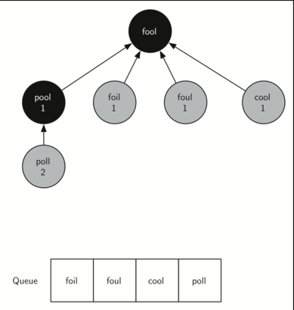
when bfs examines the node pool it finds the node cool as adjacent but the color of cool has already been changed to gray.
This indicates that there is a shorter path to cool from fool that doesn’t include pool and that cool is already on the queue for further expansion.
The only new node added to the queue while examining pool is poll

Slide 19
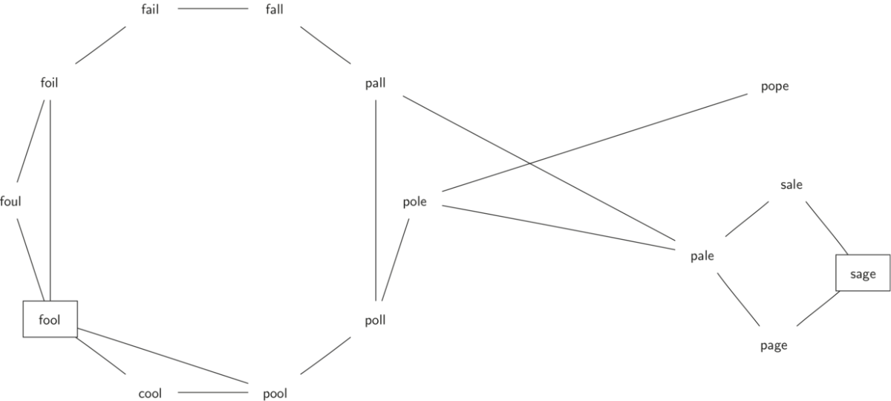
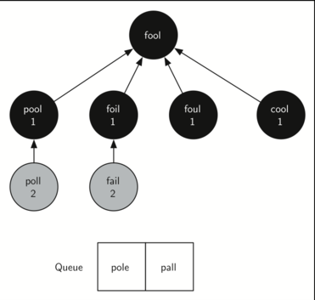
The next vertex on the queue is foil.
The only new node that foil can add to the tree is fail.
As bfs continues to process the queue, neither of the next two nodes add anything new to the queue or the tree.
The next element, poll, adds pole and pall

Slide 20
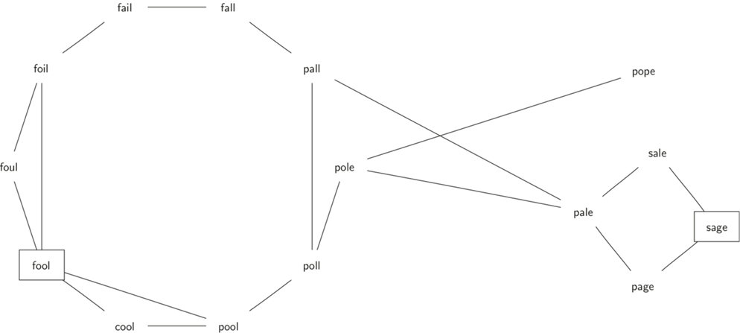
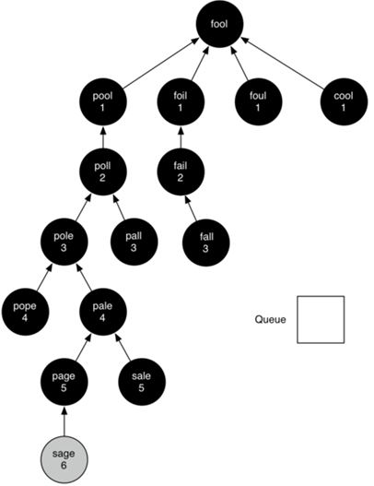
Start figure
The Figure on the right shows the final breadth first search tree after all the vertices graph have been explored.
The important thing about the breadth first search solution is that we have not only solved the FOOL–SAGE problem we started out with, but we have solved many other problems along the way.
We can start at any vertex in the breadth first search tree and follow the predecessor arrows back to the root to find the shortest word ladder from any word back to fool.

Slide 21
Applications of Breadth First Traversal
1) Shortest Path and Minimum Spanning Tree for unweighted graphs In an unweighted graph, the shortest path is the path with the least number of edges. With Breadth First Search, we always reach a vertex from given source using the minimum number of edges. Also, in case of unweighted graphs, any spanning tree is a Minimum Spanning Tree and we can use either Depth or Breadth first traversal for finding a spanning tree.
-A minimum spanning tree (MST) or minimum weight spanning tree is a subset of the edges of a connected, edge-weighted undirected graph that connects all the vertices together, without any cycles and with the minimum possible total edge weight.
2) Peer to Peer Networks. In Peer to Peer Networks like BitTorrent, Breadth First Search is used to find all neighbor nodes.
3) Crawlers in Search Engines to map a certain domain: A crawler can build an index of a domain using Breadth First traversal. The idea is to start from a source domain page (ex: op.ac.nz) and follow all links from source. The advantage with Breadth First Traversal is that you get a more representative sample of links early in the algorithmic process (which is important for algorithms that might never end, as for example if you want to map the entire Internet) but you pay a price in terms of memory requirements
You may want to think about why this is the case
4) Social Networking Websites: In social networks, we can find people within a given distance ‘k’ from a person using Breadth First Search till ‘k’ levels.
5) GPS Navigation systems: Breadth First Search is used to find all neighboring locations.
6) Broadcasting in Network: In networks, a broadcasted packet follows Breadth First Search to reach all nodes.
7) In Garbage Collection: Breadth First Search is used in copying garbage collection using Cheney’s algorithm.
8) Cycle detection in undirected graph: In undirected graphs, either Breadth First Search or Depth First Search can be used to detect cycles. In a directed graph, only depth first search can be used.
9) Ford–Fulkerson algorithm In Ford-Fulkerson algorithm, we can either use Breadth First or Depth First Traversal to find the maximum flow. Breadth First Traversal is preferred as it reduces worst case time complexity to O(VE²).
10) To test if a graph is Bipartite We can either use Breadth First or Depth First Traversal.
11) Path Finding We can either use Breadth First or Depth First Traversal to find if there is a path between two vertices.
12) Finding all nodes within one connected component: We can either use Breadth First or Depth First Traversal to find all nodes reachable from a given node.

